Slide 1
Chapter 9
Business Intelligence Systems
Notes:
This chapter considers business intelligence (BI) systems: information systems that can produce patterns, relationships, and other information from organizational structured and unstructured social data as well as from external, purchased data.

Slide 2
“Data Analysis, Where You Don’t Know the Second Question to Ask Until You See the Answer to the First One.”
Tracking race competitors, and having success selling products to them
Want to match competitors to personal trainers in same locale
Earn referral fee
How to track them? Mailing address? IP address?
Using Excel to analyze data, but …
Serious data mining needs a data mart
Notes:
GOALS: Use the PRIDE system to:
Illustrate a practical application for business intelligence systems, specifically reporting.
Show the use of animation for reporting on a mobile device.
Provide a setting to teach standard reporting terminology.
Illustrate advantages of storing data in the cloud.

Slide 3
Study Questions
Q1: How do organizations use business intelligence (BI) systems?
Q2: What are the three primary activities in the BI process?
Q3: How do organizations use data warehouses and data marts to acquire data?
Q4: What are three techniques for processing BI Data?
Q5: What are the alternatives for publishing BI?
How does the knowledge in this chapter help you?
Notes:
This chapter considers BI systems to identify patterns, relationships, and other information in organizational structured and unstructured social data, as well as purchased external data. In addition to this data, another rich source of knowledge is employees themselves.
Vast amounts of collective knowledge exist in every organization’s employees. How can that knowledge be shared?
As you will learn, business intelligence is the key technology supporting such marketing technology.

Slide 4
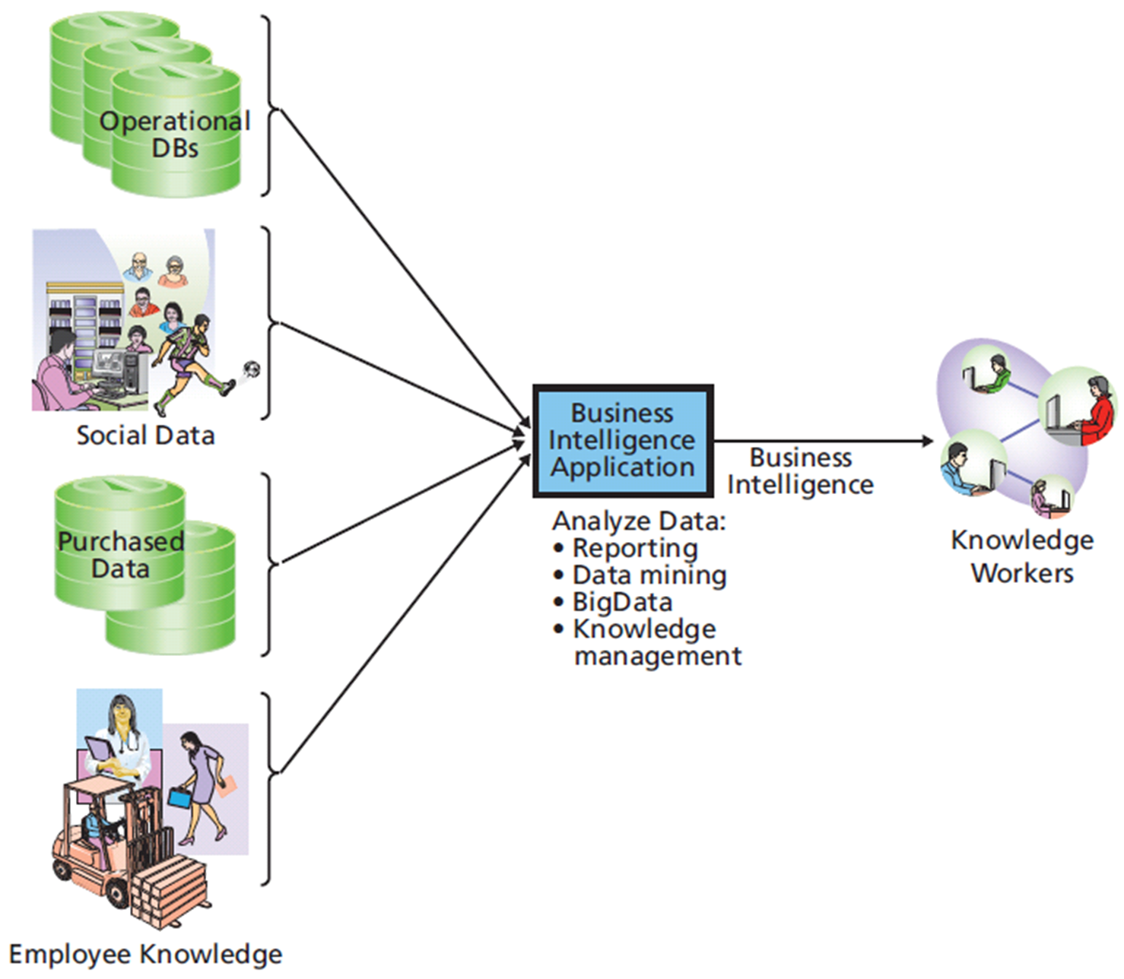
Q1: How Do Organizations Use Business Intelligence (BI) Systems?
Structure of Business Intelligence System
Notes:
BI systems are information systems that process operational and other data to identify patterns, relationships, and trends for use by business professionals and other knowledge workers.
Five standard IS components are present in BI systems: hardware, software, data, procedures, and people.
The boundaries of BI systems are blurry.

Slide 5
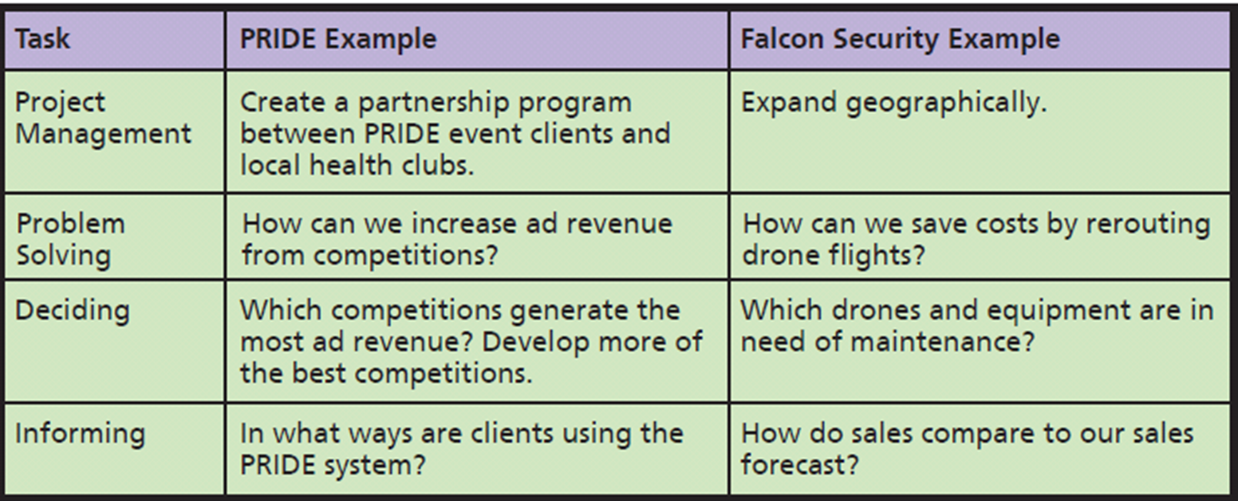
Sample of Uses of Business Intelligence
Notes:
Use BI for all four of the collaborative tasks described in Chapter 2.
Falcon Security could use BI to determine whether it could save costs by rerouting its drone flights.

Slide 6
What Are Typical Uses for BI?
Identifying changes in purchasing patterns
Important life events change what customers buy
BI for Entertainment
Netflix has data on watching, listening, and rental habits
Classify customers by viewing patterns
Just-in-Time Medical Reporting
Real-time injection notification services to doctors during exams
Notes:
Typical uses involve classification or prediction.
Excellent example of data mining and reporting in real time.

Slide 7
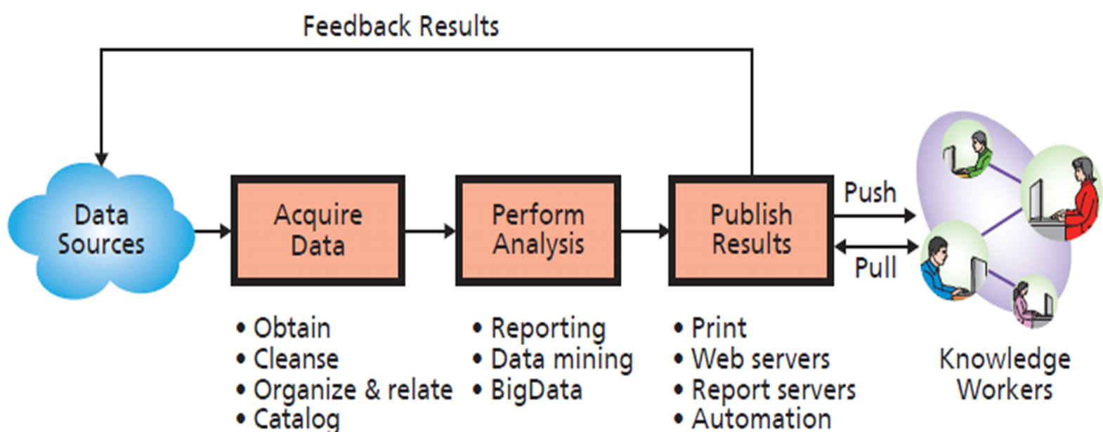
Q2: What Are the Three Primary Activities in the BI Process?
Notes:
Push publishing delivers business intelligence to users without any request from the users according to a schedule or as a result of an event or particular data condition.
Pull publishing requires the user to request BI results.

Slide 8
Using Business Intelligence to Find Candidate Parts at Falcon Security
Candidate parts
Provided by vendors who agree to make part design files available for sale
Purchased by larger customers
Frequently ordered parts
Ordered in small quantities
Simple in design (easier to 3D print)
Part weight and price surrogates for simplicity
Notes:
Obtained an extract of sales data from its IS department and stored it in Microsoft Access.

Slide 9
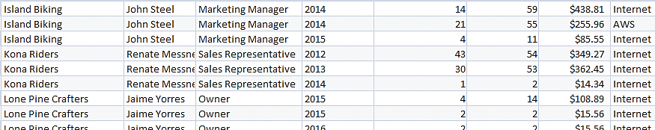
Acquire Data: Extracted Order Data
Query
Sales (CustomerName, Contact, Title, Bill Year, Number Orders, Units, Revenue, Source, PartNumber)
Part (PartNumber, Shipping Weight, Vendor)
Notes:
IS department extracted the data from Sales and Part tables.
Actually wouldn’t need all of the data columns in the Sales table.
Data was divided into different billing years, which wouldn’t affect analysis.

Slide 10
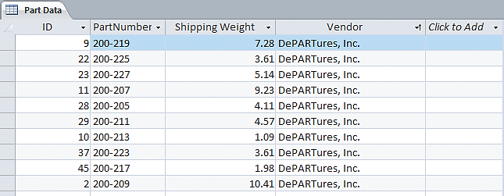
Sample Extracted Data: Part Table
Notes:
Actually wouldn’t need all of the data columns in the Sales table.
They were surprised that the data was divided into different billing years, but because they planned to sum item sales over those years, that division wouldn’t affect their analysis.

Slide 11
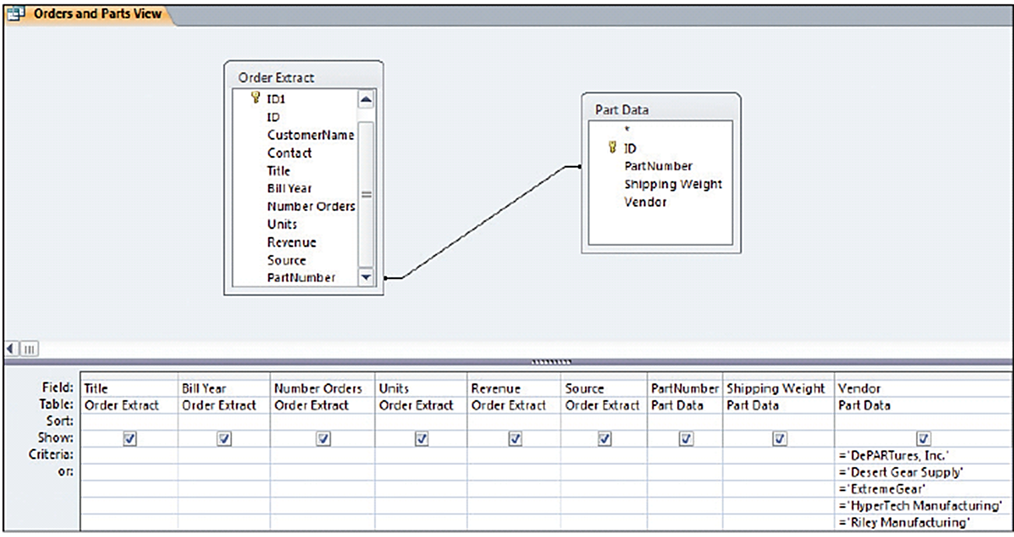
Joining Order Extract and Filtered Parts Tables
Notes:
First step was to combine the data in the two tables into a single table that contained both the sales and part data.

Slide 12
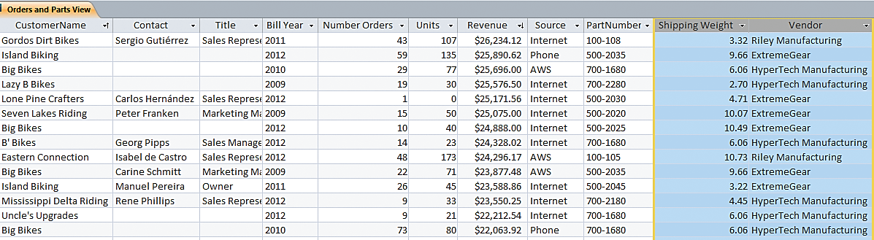
Sample Orders and Parts View Data
Notes:
Data in Figure 9-6 has been filtered for their first criterion, to consider parts only from particular vendors.
Notice some missing and questionable values. Numerous rows have missing values of Contact and Title, and a few rows have value of zero for Units. Missing contact and title data isn’t a problem.

Slide 13
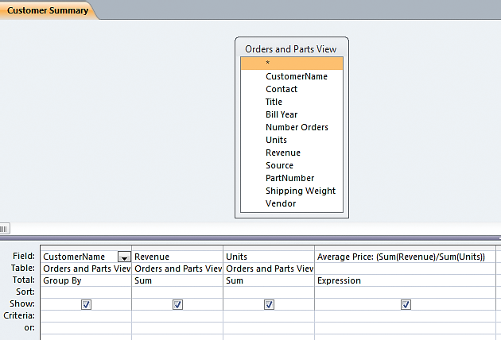
Creating Customer Summary Query
Notes:
Sums the revenue, units, and average price for each customer.

Slide 14
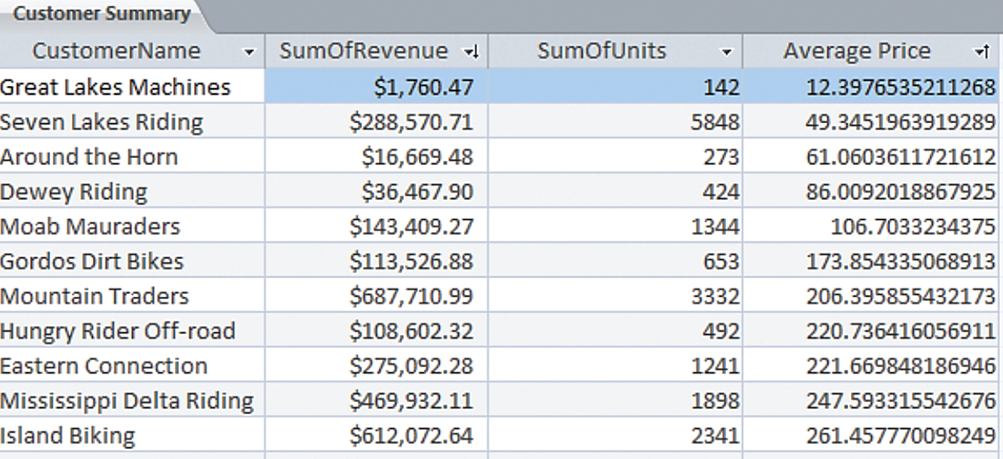
Customer Summary

Slide 15
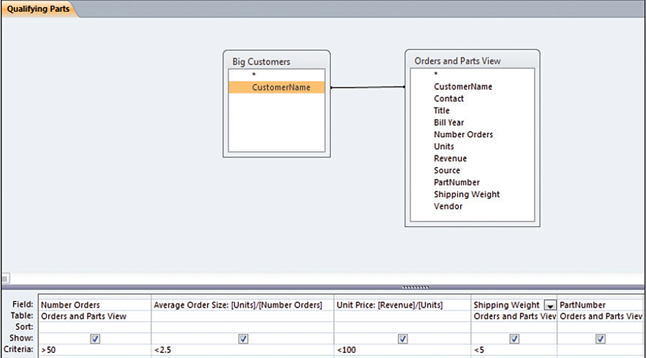
Qualifying Parts Query Design
Notes:
Filtered by customers having more than $200,000 in total revenue.

Slide 16
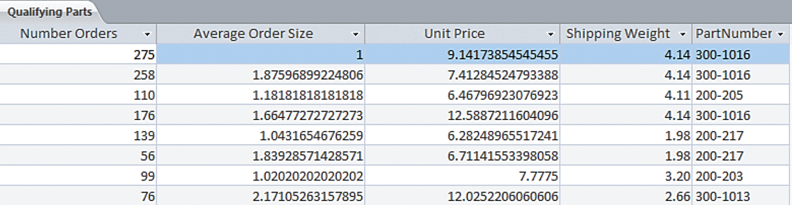
Publish Results: Qualifying Parts Query Results
Notes:
Publish results is the last activity in the BI process.

Slide 17
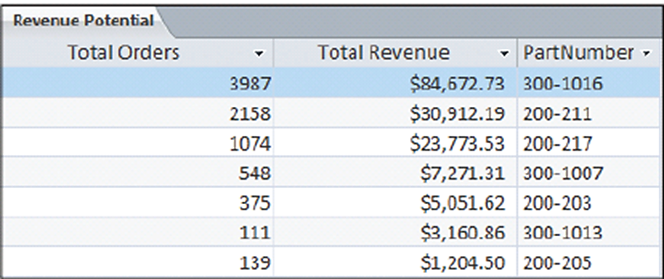
Publish Results: Sales History for Selected Parts
Notes:
Judging just by the results, there seems to be little revenue potential in selling designs for these parts.
It is possible they chose the wrong criteria.
Might find themselves changing criteria until they obtain a result they want, which results in a very biased study.
Importance of the human component of an IS. Business intelligence is only as intelligent as the people creating it!

Slide 18
Q3: How Do Organizations Use Data Warehouses and Data Marts to Acquire Data?
Data Warehouse Functions
Obtain data from operational, internal and external databases
Cleanse data
Organize and relate data
Catalog data using metadata
Notes:
For a small organization, the extraction may be as simple as an Access database. Larger organizations, however, typically create and staff a group of people who manage and run a data
warehouse, which is a facility for managing an organization’s BI data.

Slide 19
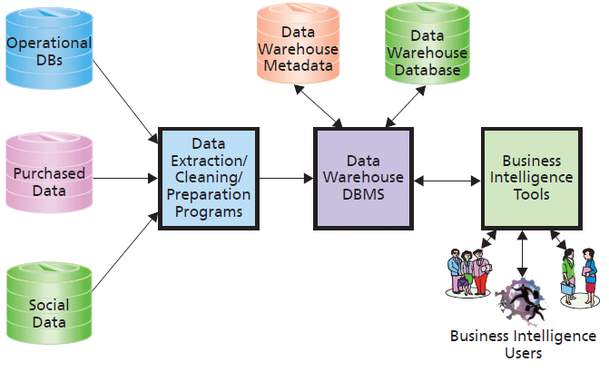
Components of a Data Warehouse
Notes:
This figure shows the components of a data warehouse. Programs read operational and other data and extract, clean, and prepare that data for BI processing.
An organization might use Oracle for its operational processing, but use SQL Server for its data warehouse. Other organizations use SQL Server for operational processing, but use DBMSs from statistical package vendors such as SAS or SPSS in the data warehouse.

Slide 20
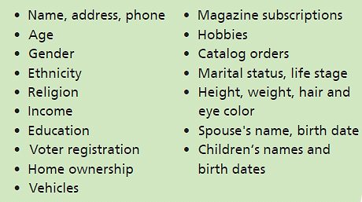
Examples of Consumer Data That Can Be Purchased
Notes:
Purchase of data about other organizations is not unusual or particularly concerning from a privacy standpoint.
However, some companies choose to buy personal, consumer data (like marital status) from data vendors like Acxiom Corporation.

Slide 21
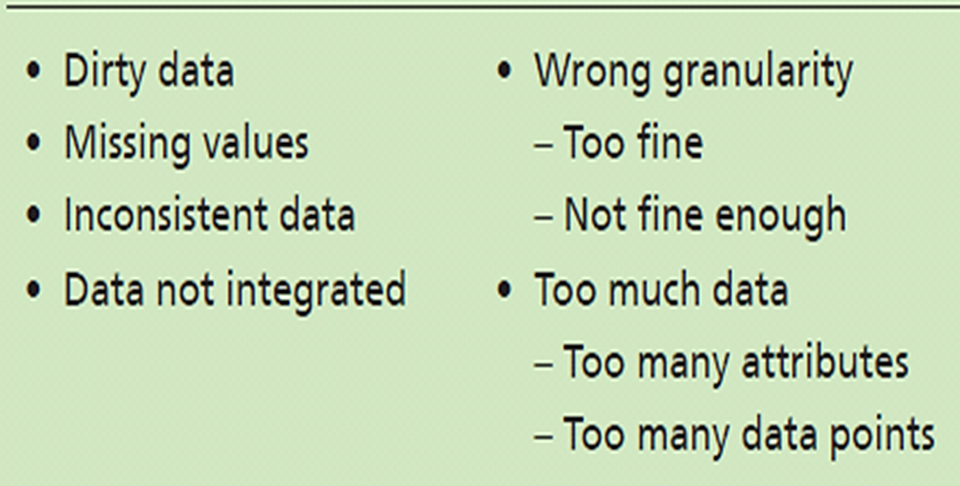
Possible Problems with Source Data
Curse of dimensionality
Notes:
Most operational and purchased data have problems that inhibit their usefulness for BI analysis.
Problematic data is termed dirty data. Examples are a value of B for customer gender and of 213 for customer age. Other examples are a value of 999–999–9999 for a U.S. phone number, a part color of “gren,” and an email address of WhyMe@GuessWhoIAM.org. The value of zero for Units in Figure 9-6 is dirty data.

Slide 22
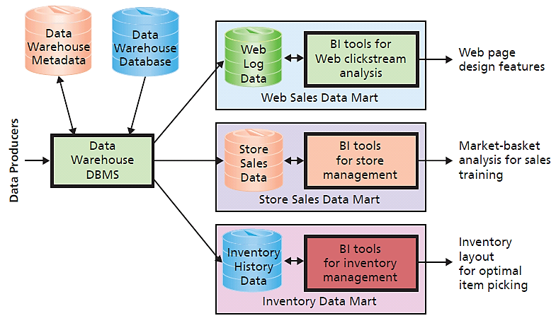
Data Warehouses Versus Data Marts
Notes:
The data analysts who work with a data warehouse are experts at data management, data cleaning, data transformation, data relationships, and the like. However, they are not usually experts in a given business function.
A data mart is a subset of a data warehouse. A date mart addresses a particular component or functional area of the business.

Slide 23
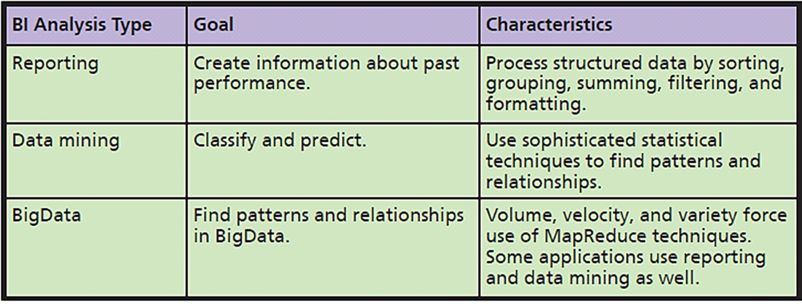
Q4: What are Three Techniques for Processing BI Data?
Notes:
In general, reporting analyses are used to create information about past performance, whereas data mining is used primarily for classifying and predicting. There are exceptions, but these statements are reasonable rules of thumb.
The goal of BigData analysis is to find patterns and relationships in the enormous amounts of data generated from sources like social media sites or Web server logs. As indicated, BigData data techniques can include reporting and data mining as well.

Slide 24
Reporting Analysis
Process of sorting, grouping, summing, filtering, and formatting structured data
Structured data
Data in rows and columns like tables
Exception reports
Produced when something out of predefined bounds occurs
Printed and dynamic reports
Notes:
Reporting analysis is the process of sorting, grouping, summing, filtering, and formatting
structured data. Structured data is data in the form of rows and columns. Most of the time
structured data means tables in a relational database, but it can refer to spreadsheet data as well.
The parts analysis you read in Q2 is an example of a reporting analysis. Another type of
report, exception reports are reports produced when something out of predefined bounds
occurs.

Slide 25
Data Mining
Application of statistical techniques to find patterns and relationships among data for classification and prediction
Combined discipline of statistics, mathematics, artificial intelligence, and machine-learning

Slide 26
Two Broad Categories of Data Mining
Unsupervised procedures
Does not start with a priori hypothesis or model
Hypothesized model created afterward based on analytical results to explain patterns found
Example: Cluster analysis
Notes:
Cluster analysis: Statistical technique to identify groups of entities with similar characteristics; used to find groups of similar customers from customer order and demographic data

Slide 27
Supervised Data Mining
Uses a priori model to compute outcome of model
Prediction, such as multiple linear regression
Ex: CellPhoneWeekendMinutes
= (12 + (17.5*CustomerAge)+(23.7*NumberMonthsOfAccount)
= 12 + 17.5*21 + 23.7*6 = 521.7
Notes:
Predict number of minutes of weekend cell phone use.

Slide 28
BigData
Huge volume
Petabyte and larger
Rapid velocity
Generated rapidly
Great variety
Structured data, free-form text, log files, graphics, audio, and video
Notes:
BigData analysis can involve both reporting and data mining techniques. The chief difference is, however, that BigData has volume, velocity, and variation characteristics that far exceed those of traditional reporting and data mining.

Slide 29
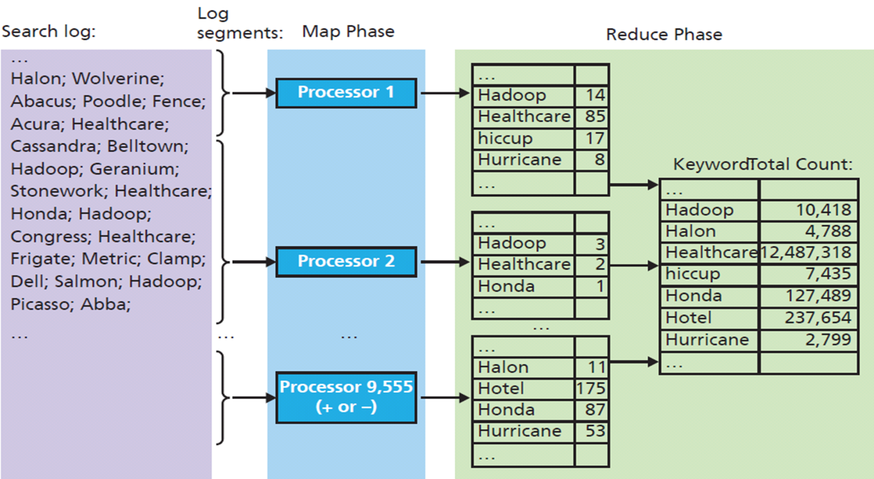
MapReduce Processing Summary
Google search log broken into pieces
Notes:
Technique for harnessing power of thousands of computers working in parallel

Slide 30
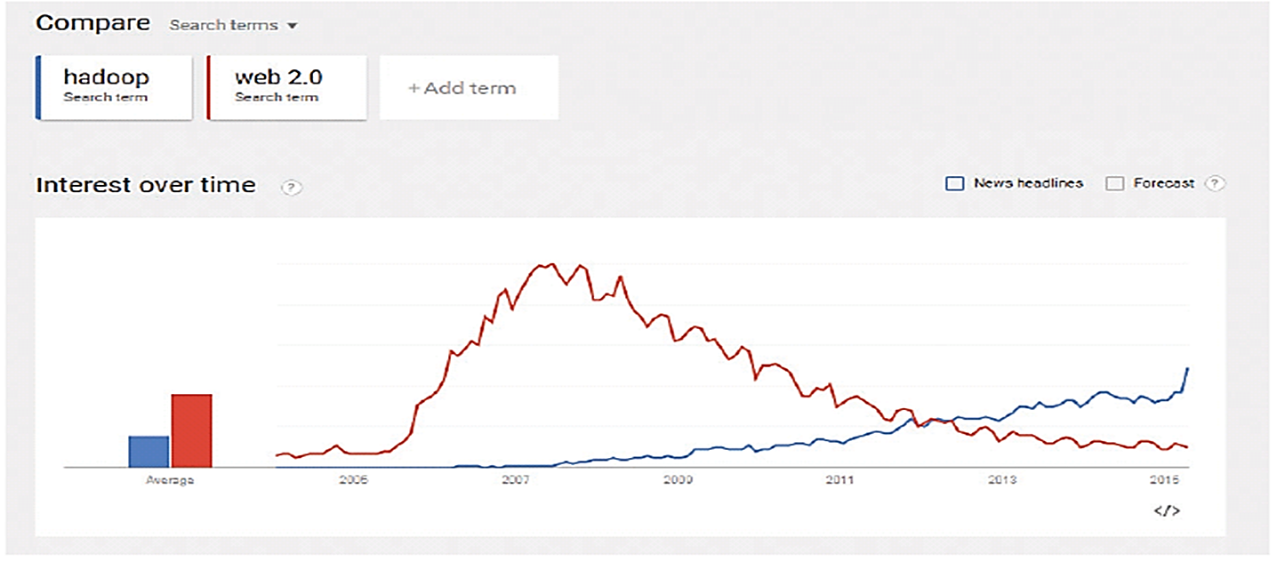
Google Trends on the Term Web 2.0
Notes:
This trend line supports contention that “Web 2.0” is fading from use.

Slide 31
Hadoop
Open-source program supported by Apache Foundation
Manages thousands of computers
Implements MapReduce
Written in Java
Amazon.com supports Hadoop as part of EC3 cloud offering
Pig query language platform for large dataset analysis
Easy to master
Extensible
Automatically optimizes queries on map-reduce level

Slide 32
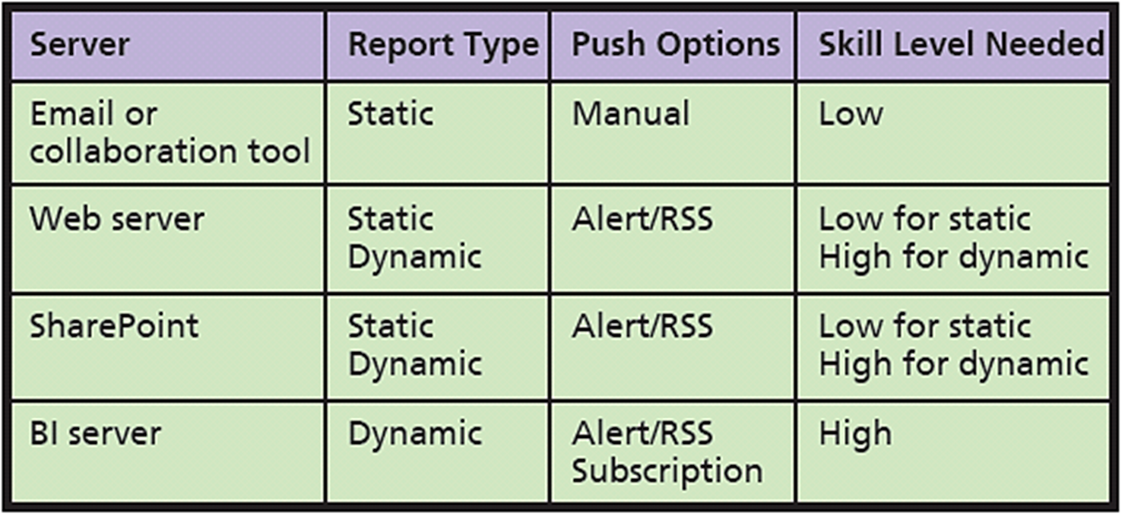
Q5: What Are the Alternatives for Publishing BI?
Notes:
Characteristics of BI Publishing Alternatives.
Subscriptions are user requests for particular BI results on a particular schedule or in response to particular events.

Slide 33
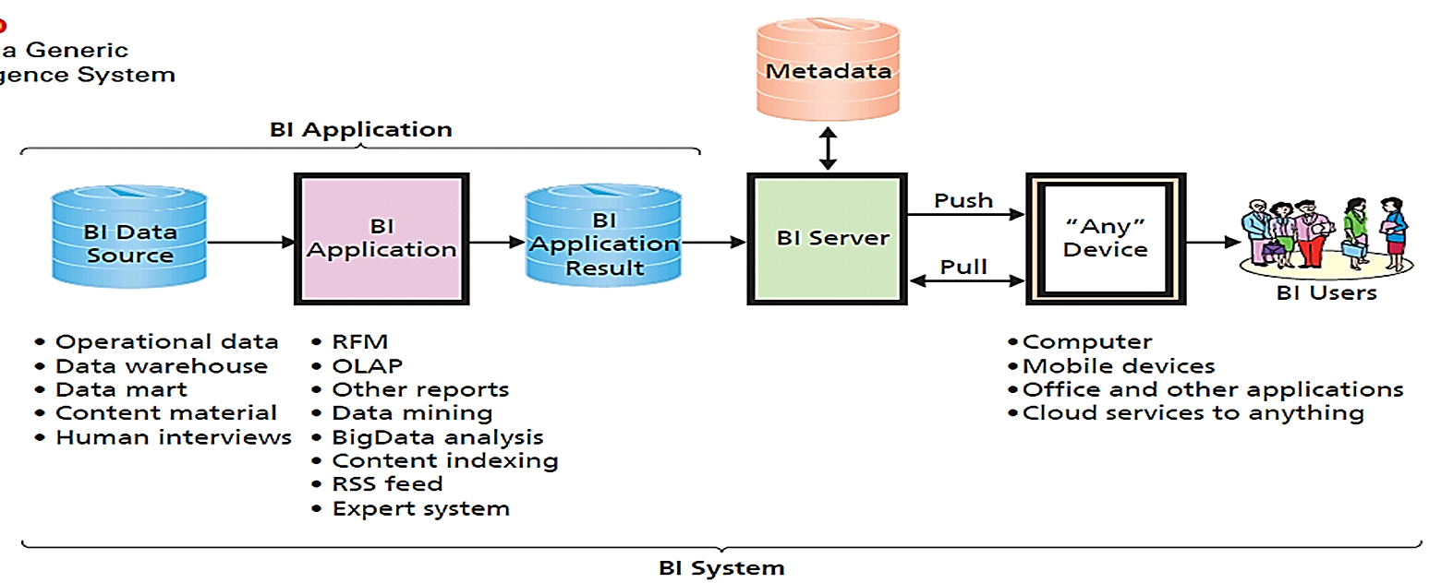
What Are the Two Functions of a BI Server?

Slide 34
How Does the Knowledge in This Chapter Help You?
Business intelligence a critical skill
Enables imagining innovative uses for data your employer generates and know some of constraints of such use
Digital marketing #1 priority for technology investment
At PRIDE, knowledge of this chapter helps understand possible uses for exercise data

Slide 35
Ethics Guide: Unseen Cyberazzi
Data broker or Data aggregator
Acquires and purchases consumer and other data from public records, retailers, Internet cookie vendors, social media trackers, and other sources
Used to create business intelligence to sell to companies and governments
Notes:
GOAL
Sensitize students to the use of data generated and processed about them.
Illustrate some of the uses of frequent-buyer data.

Slide 36
Ethics Guide: Unseen Cyberazzi (cont'd)
Cheap cloud processing makes processing consumer data easier, less expensive
Processing happens in secret
Data brokers enable you to view data stored about you, but:
Difficult to learn how to request your data
Torturous process to file for it
Limited data usefulness
Notes:
Help students understand the importance not just of what data is being gathered about them, but what analyses and conclusions are being made from that data, behind their back.

Slide 37
Ethics Guide: Unseen Cyberazzi (cont'd)
Do you know what data is gathered about you? What is done with it?
Have you thought about conclusions data aggregators, or their clients, could make based on your use of frequent buyer cards?
Concerned about what federal government might do with data it gets from data aggregators?
Where does all of this end?
What will life be like for your children or grandchildren?
Notes:
Great questions for class discussion or debate.

Slide 38
Guide: Semantic Security
Unauthorized access to protected data and information
Physical security
Passwords and permissions
Delivery system must be secure
Unintended release of protected information through reports and documents
What, if anything, can be done to prevent what Megan did?
Notes:
GOALS
Discuss trade-off between information availability and security.
Introduce, explain, and discuss ways to respond to semantic security.
Megan is able to combine data in various reports to infer protected information about company employees.
She was not supposed to see this information, but only used reports she was authorized to see.

Slide 39
Active Review
Q1: How do organizations use business intelligence (BI) systems?
Q2: What are the three primary activities in the BI process?
Q3: How do organizations use data warehouses and data marts to acquire data?
Q4: What are three techniques for processing BI Data?
Q5: What are the alternatives for publishing BI?
How does the knowledge in this chapter help you?

Slide 40
Case Study 9: Hadoop the Cookie Cutter
Third-party cookie created by a site other than one you visited
Most commonly occurs when a Web page includes content from multiple sources
DoubleClick
IP address where content was delivered
Records data in cookie log

Slide 41
Case Study 9: Hadoop the Cookie Cutter (cont'd)
Third-party cookie owner has history of what was shown, what ads clicked, and intervals between interactions
Cookie log
Contains data on how you respond to ads and your pattern of visiting various Web sites where ads placed

Slide 42
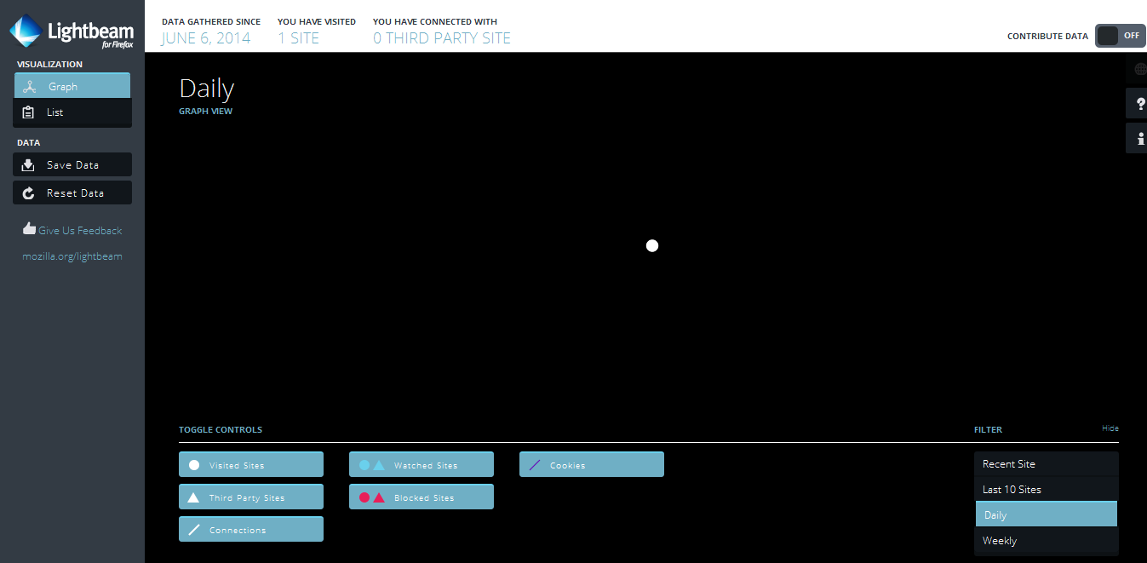
FireFox Lightbeam: Start Up Display
No Cookies
Notes:
FireFox has an optional feature tracks and graphs all the cookies on your computer.

Slide 43
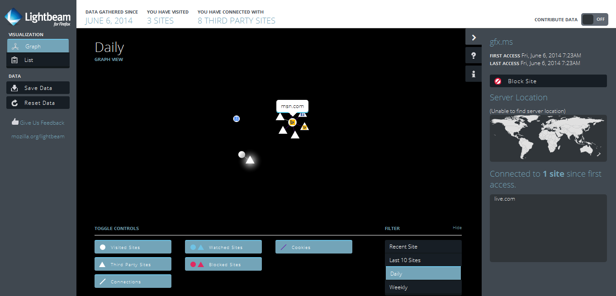
Cookies After Visiting MSN.com and Gmail

Slide 44
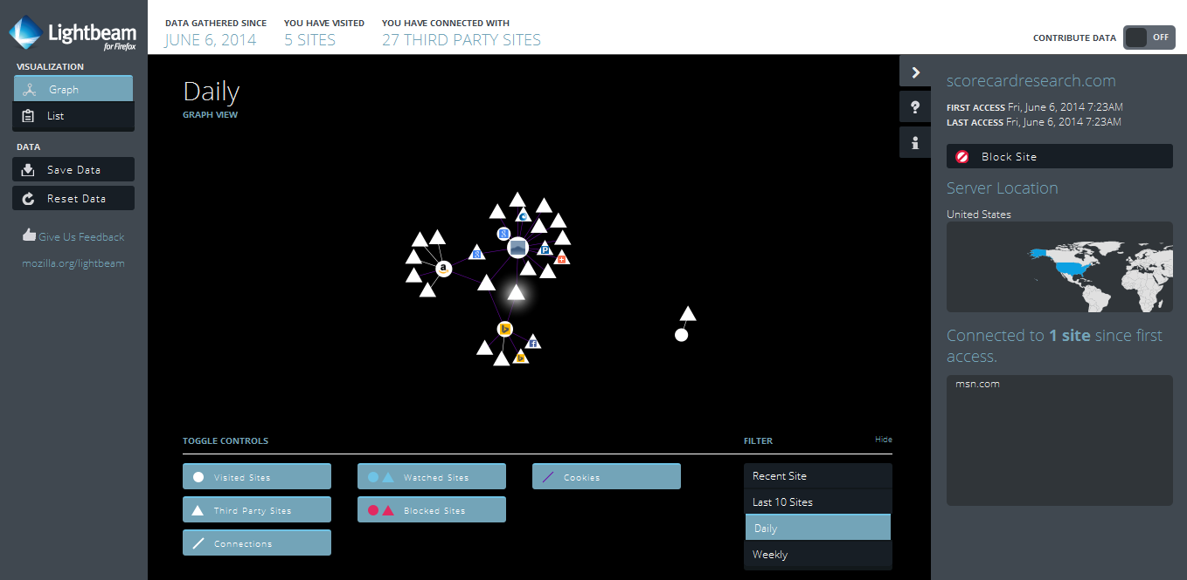
Five Sites Visited Yield 27 Third Parties
Notes:
Growing number of cookies.

Slide 45
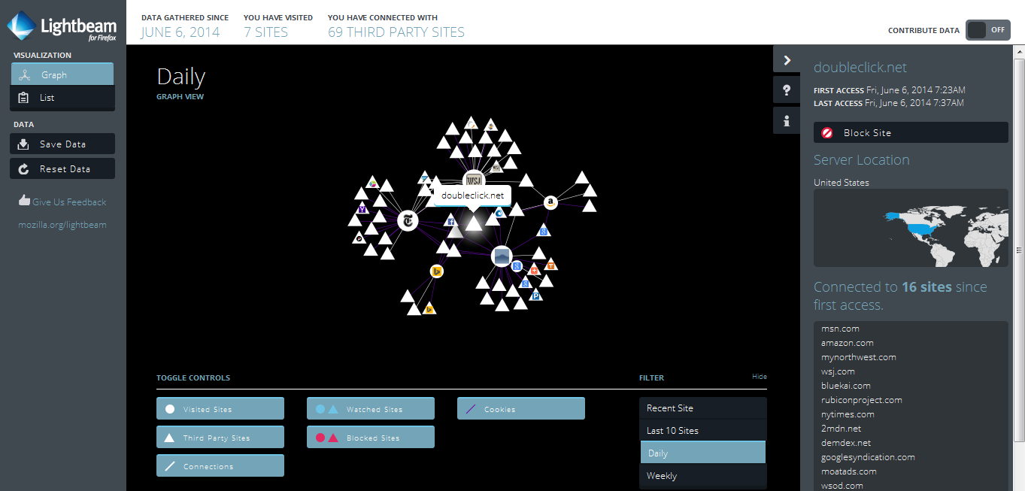
Sites Connected to Doubleclick

